Slide 1

Exploratory Data Analysis
G2M CASE STUDY
Virtual Internship
20th November 2023

Slide 2

Agenda
Problem Statement
Approach
EDA
EDA Summary
Recommendations

Slide 3
Problem Statement
XYZ is a private firm in US. Due to remarkable growth in the Cab Industry in last few years and multiple key players in the market, it is planning for an investment in Cab industry and as per their Go-to-Market(G2M) strategy they want to understand the market before taking final decision.
Project Delivery
You've received several datasets containing information about two cab companies. Each file represents distinct aspects of customer profiles. XYZ is seeking your actionable insights to assist them in determining the ideal company for their investment.
Approach
The analysis has been done by using below pointers
Data Exploration and understanding
Analysis to find the dominant cab company in terms of profitability, customer reach, customer retention, city wise cab users etc.
Recommendations for investment

Slide 4
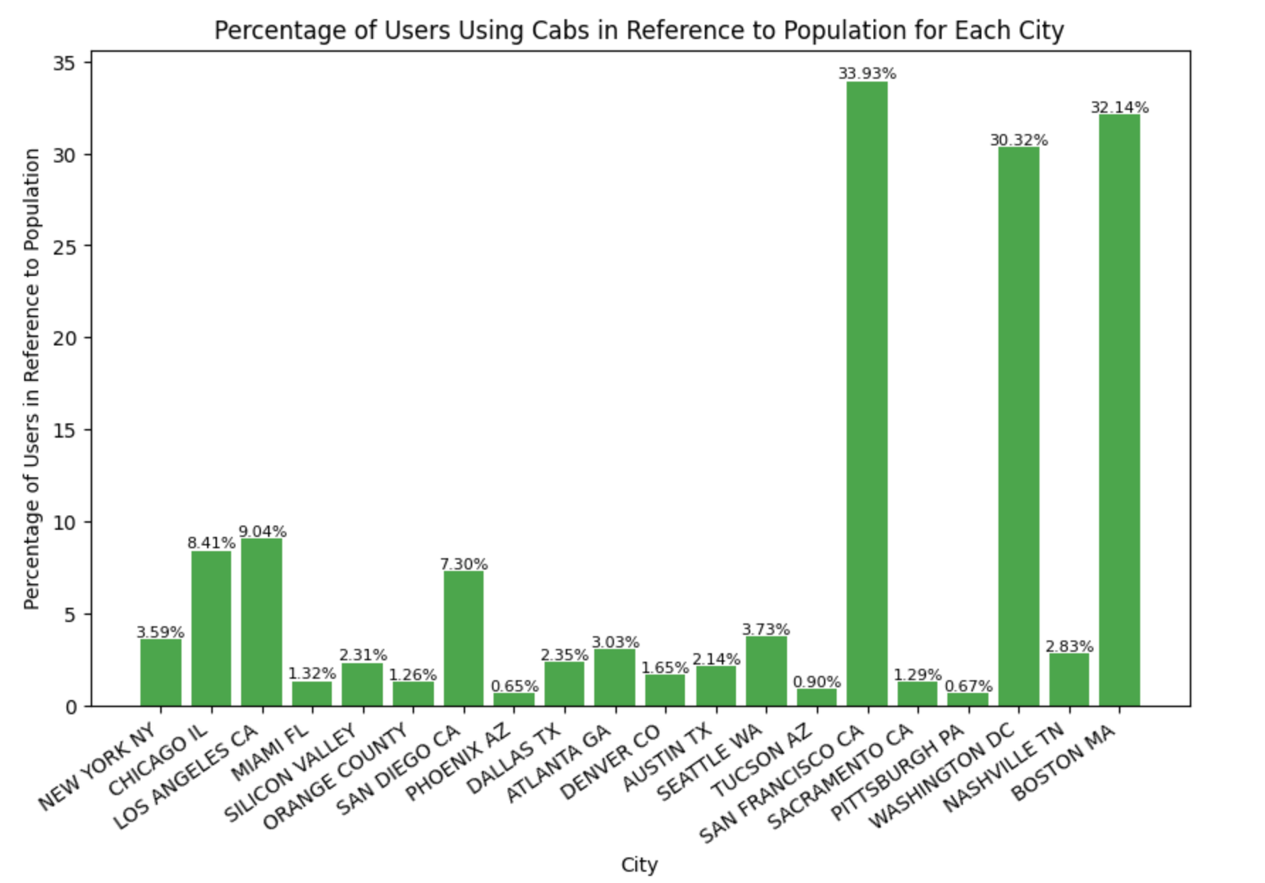
Cab Users In Each City
SanFrancisco CA, Washington DC and Boston has the highest numbers of users

Slide 5
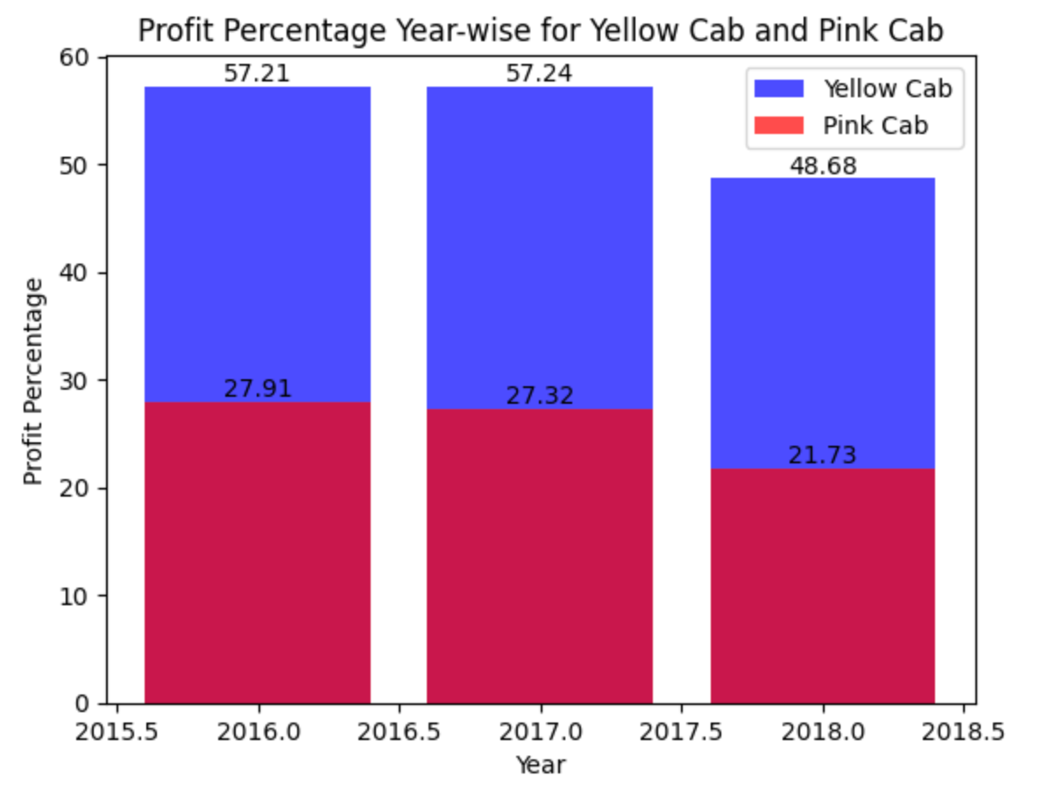
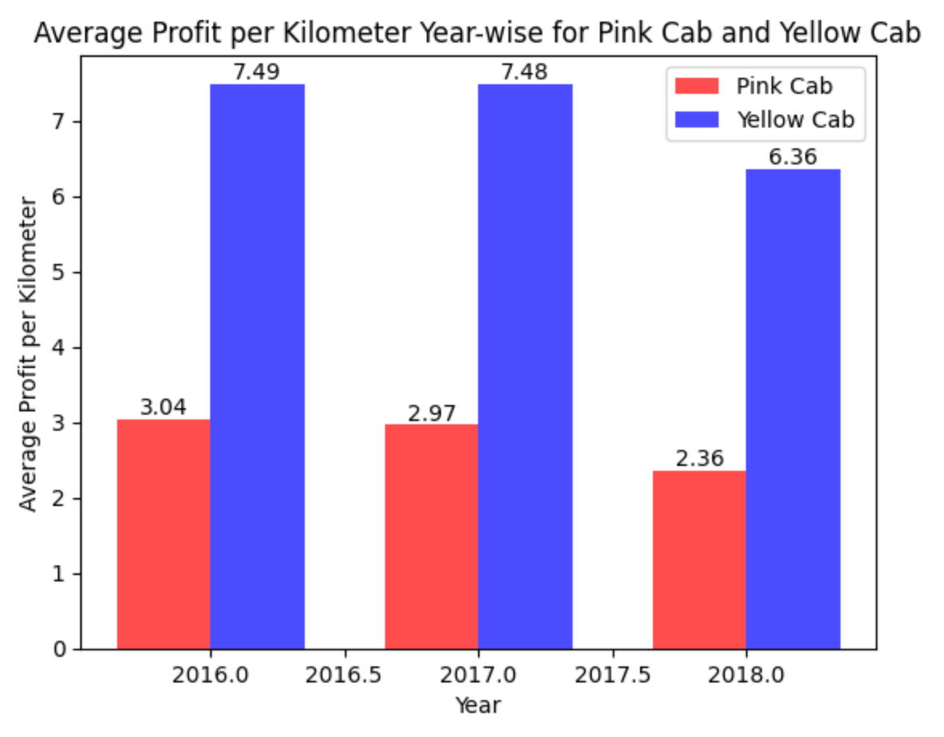
Profit Analysis – Average Profit Per KM
Yellow cab has higher profit % for each year
Yellow cab has more than two times profit margin per km than pink cab company

Slide 6
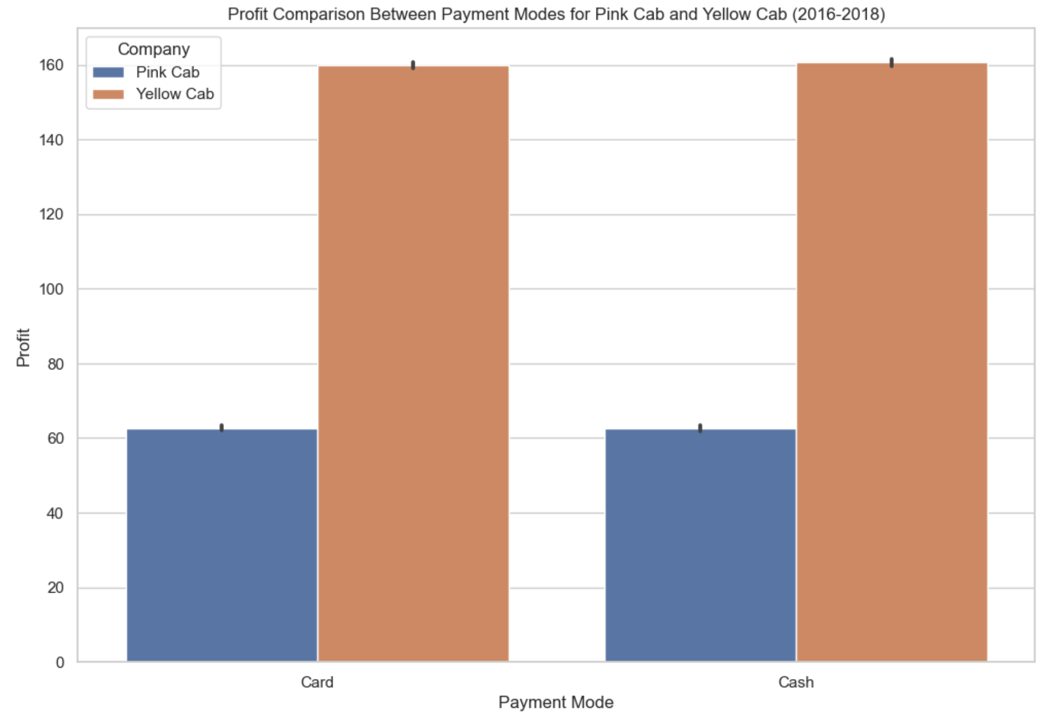
Profit Analysis – Cash and Card Transactions
There is almost equal transactions by Yellow and Pink Cab companies in terms of cash or card

Slide 7
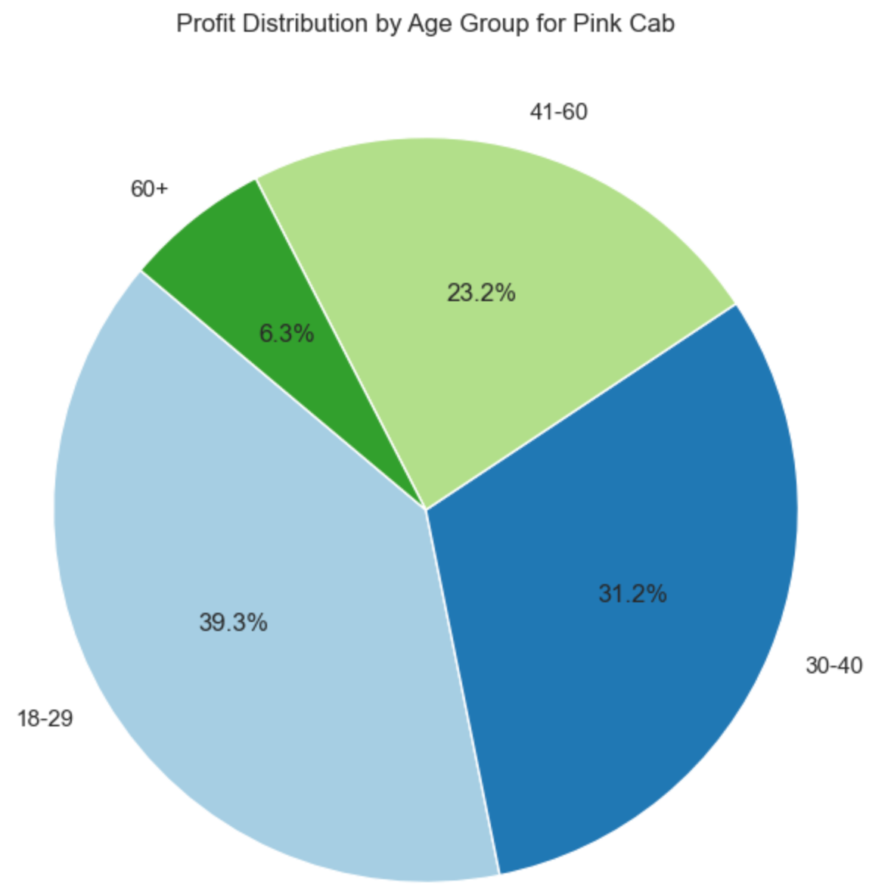
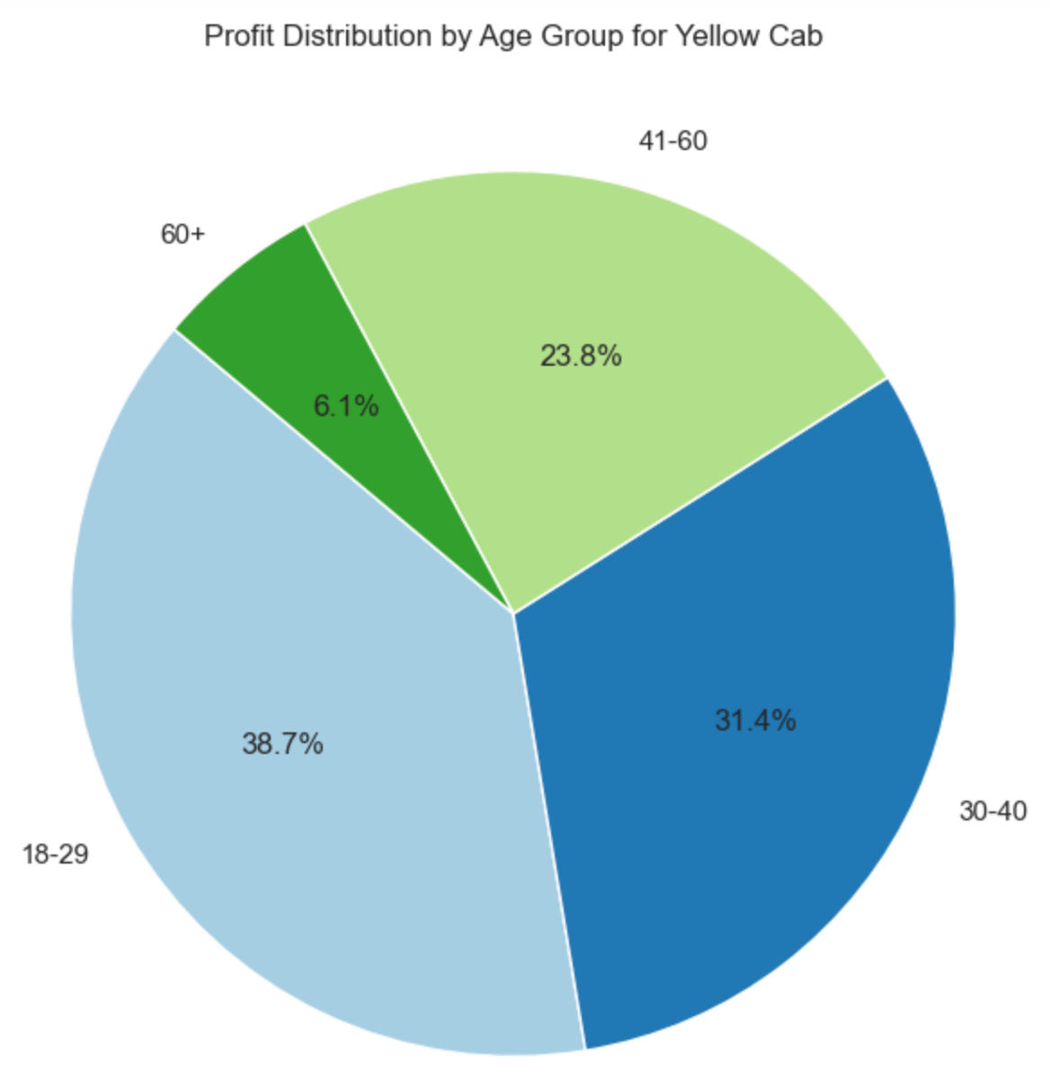
Profit and Customer base Analysis Age Wise
Both cab companies have highest profit contribution from age group of 18-29. Other than that, both companies has almost equal % profit share from other age groups.

Slide 8
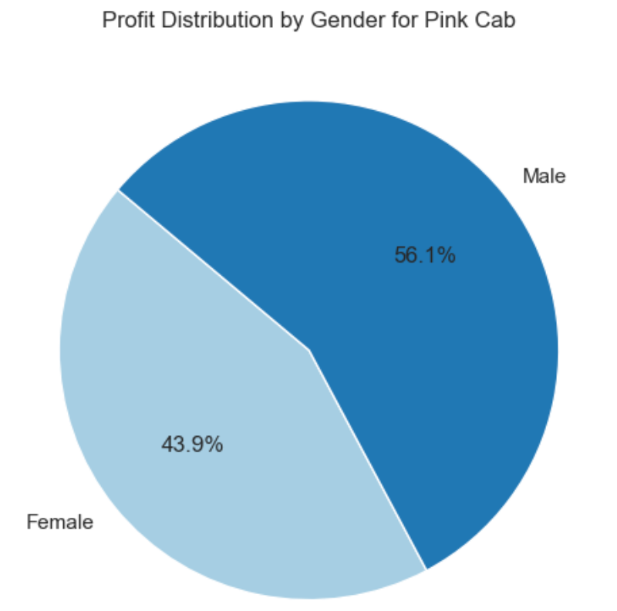
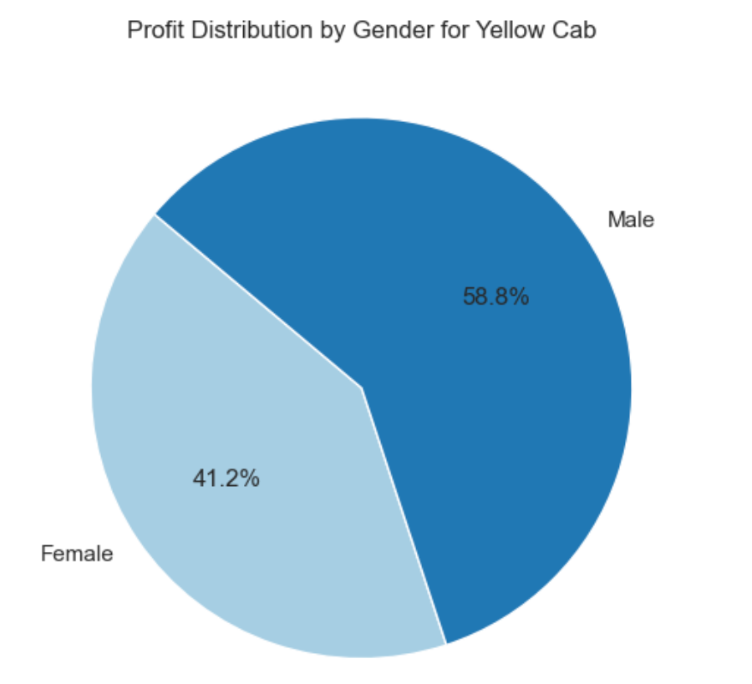
Profit and Customer base Analysis Gender wise
The distribution of gender in both the profit and customer base appears to be relatively balanced for both Pink Cab and Yellow Cab. There is no significant gender bias, as the percentages of profit contribution and the customer base are fairly evenly distributed between male and female customers for both cab companies.

Slide 9
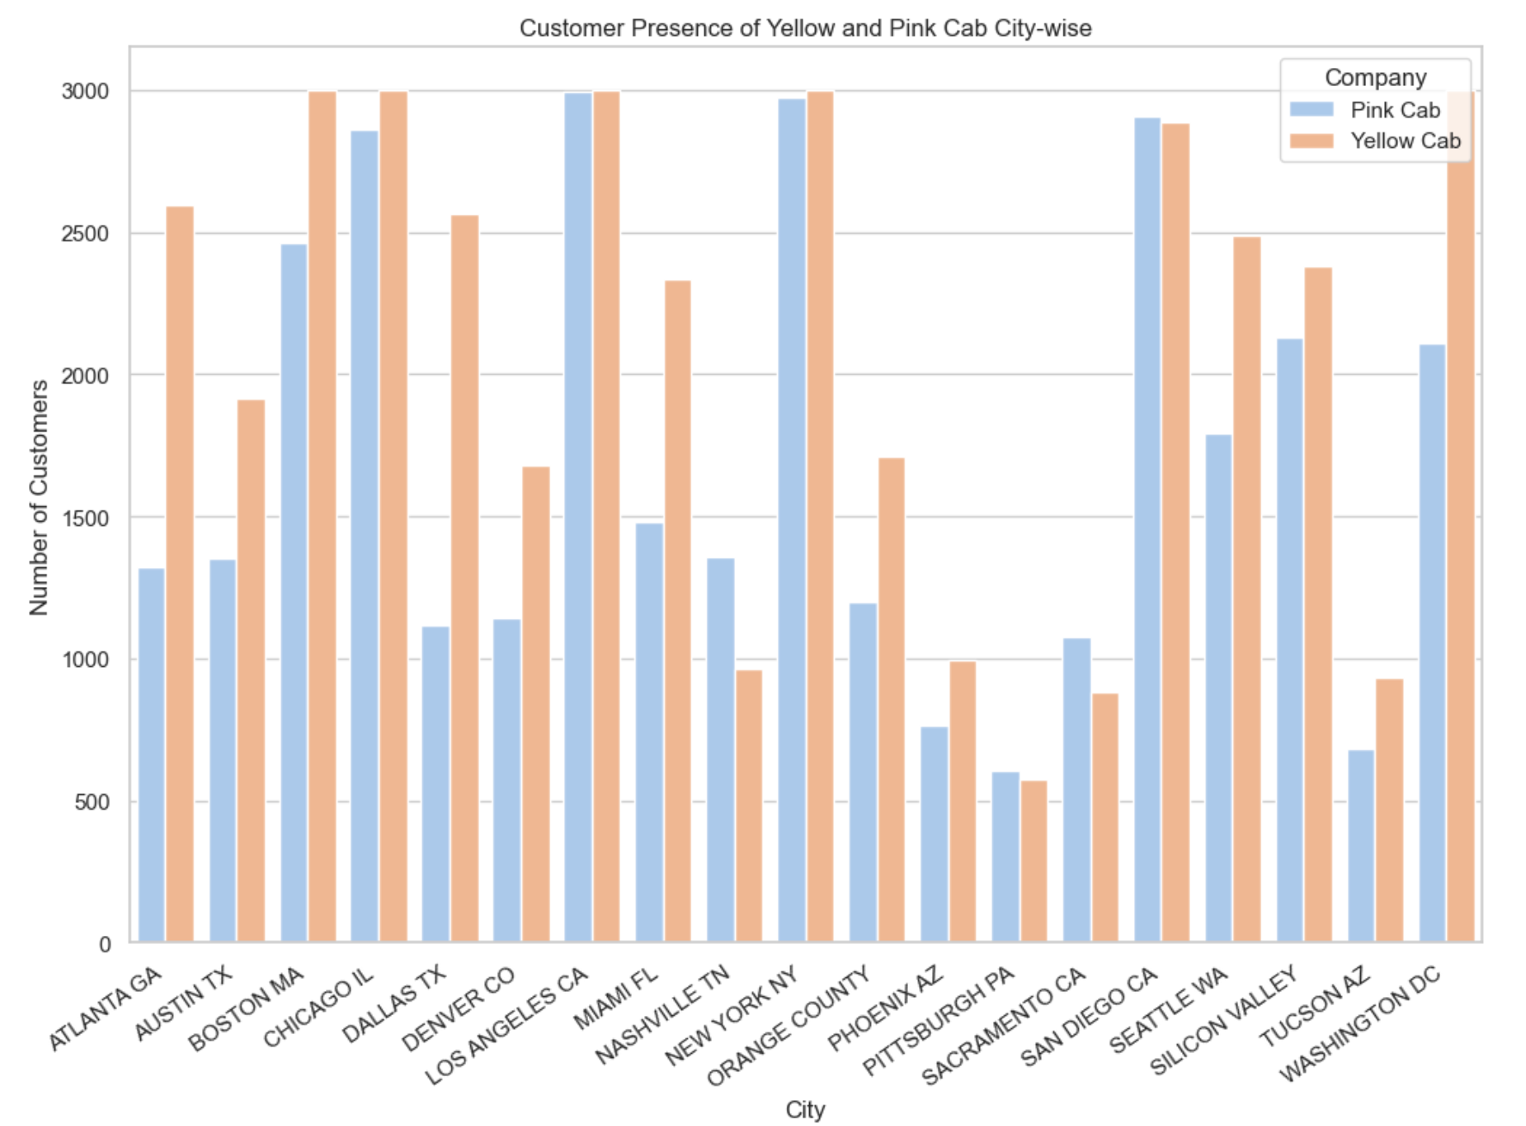
User Presence of cab companies' city wise
Yellow cab has 15 cities with more users than Pink Cab.
Pink cab has a greater customer reach in following 4 cities:
1.San Diego 2.Nashville 3.Sacramento 4.Pittsburgh

Slide 10
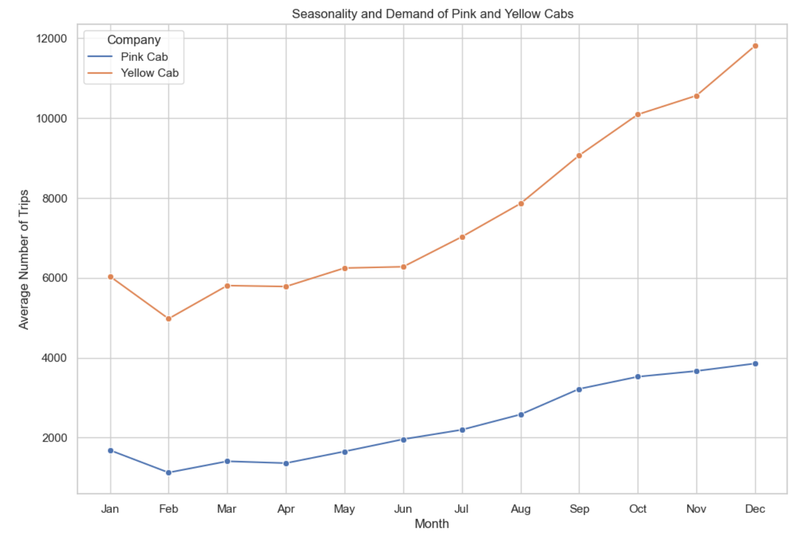
Demand of Pink and Yellow cabs Monthly
Average number of trips for both companies increases from July to December. December being the highest, while the lowest trips are in the month of February.

Slide 11
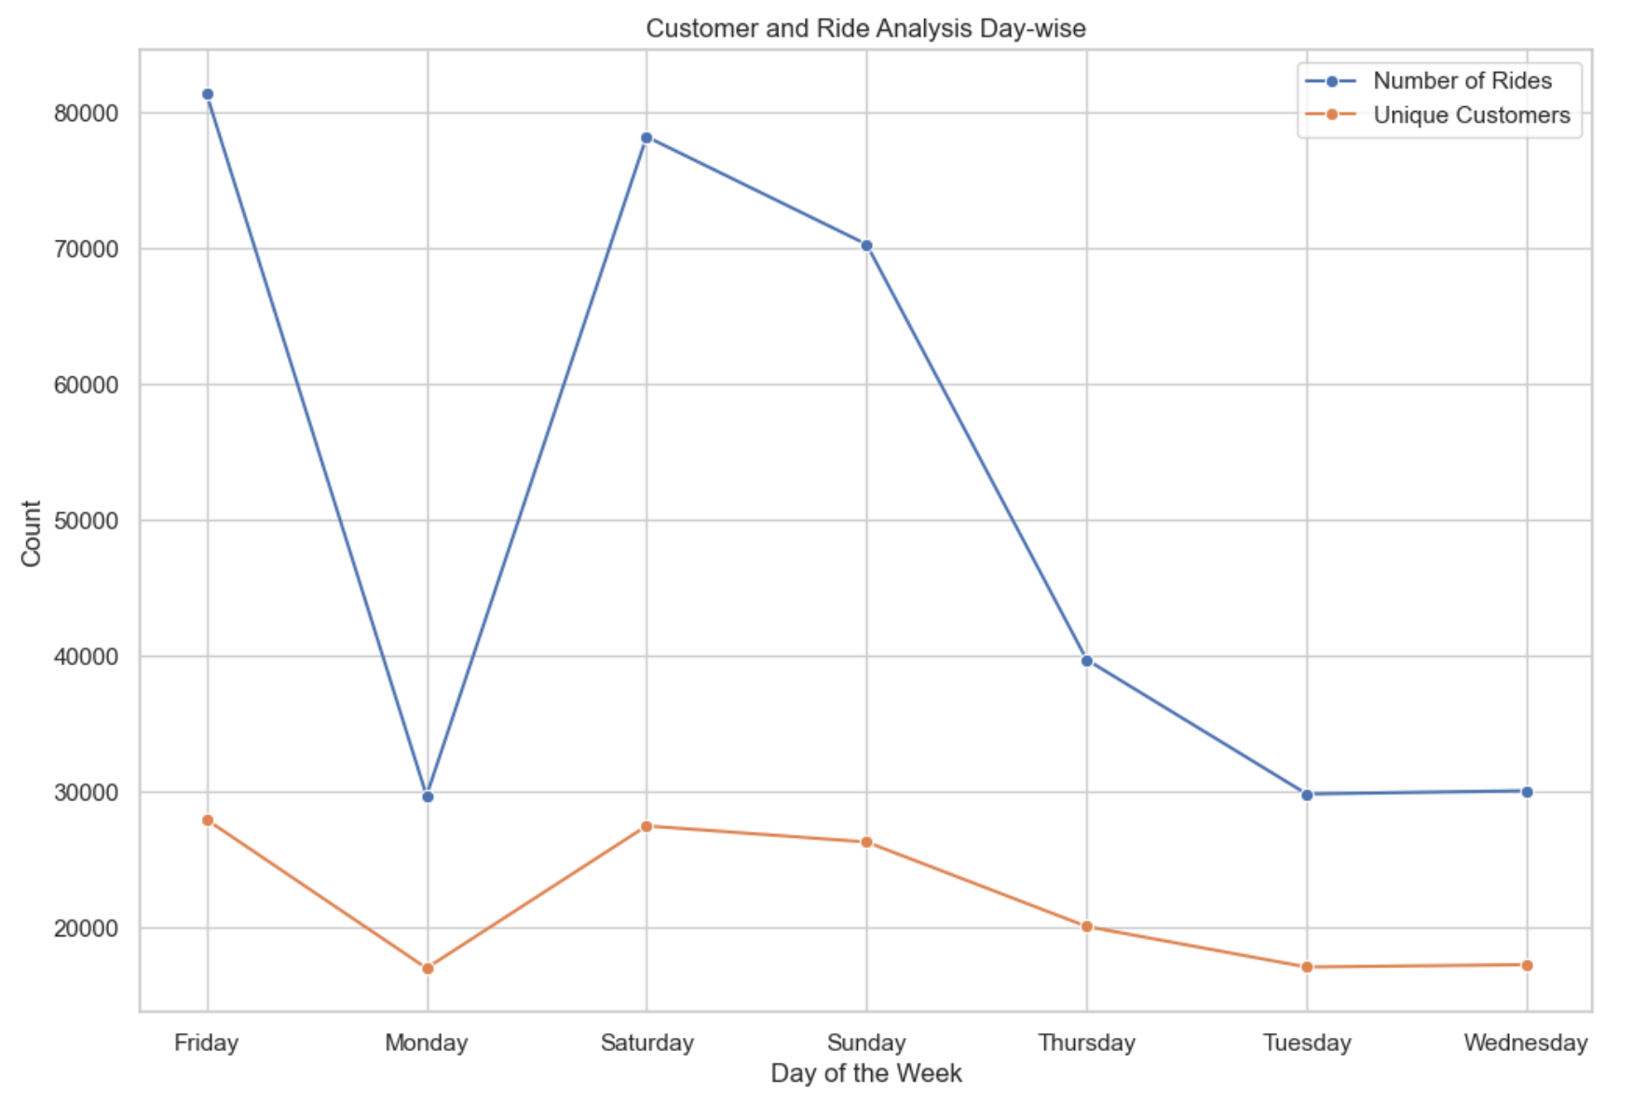
Demand of Pink and Yellow cabs Day-Wise
Both companies show higher demand during weekends. While the rides are least on Monday.

Slide 12
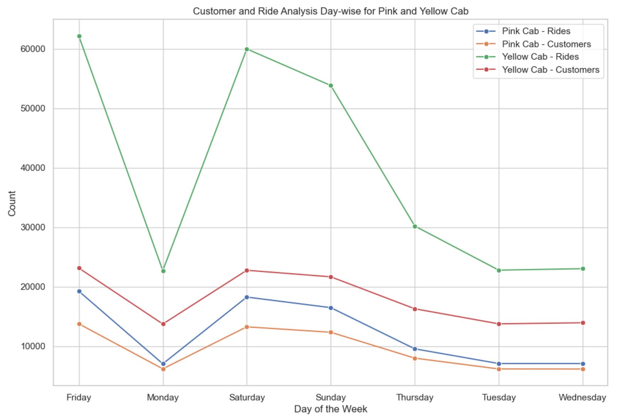
Ride And Customer Analysis Day Wise
Both companies show higher demand during weekends. While the rides and customers are least on Monday.

Slide 13
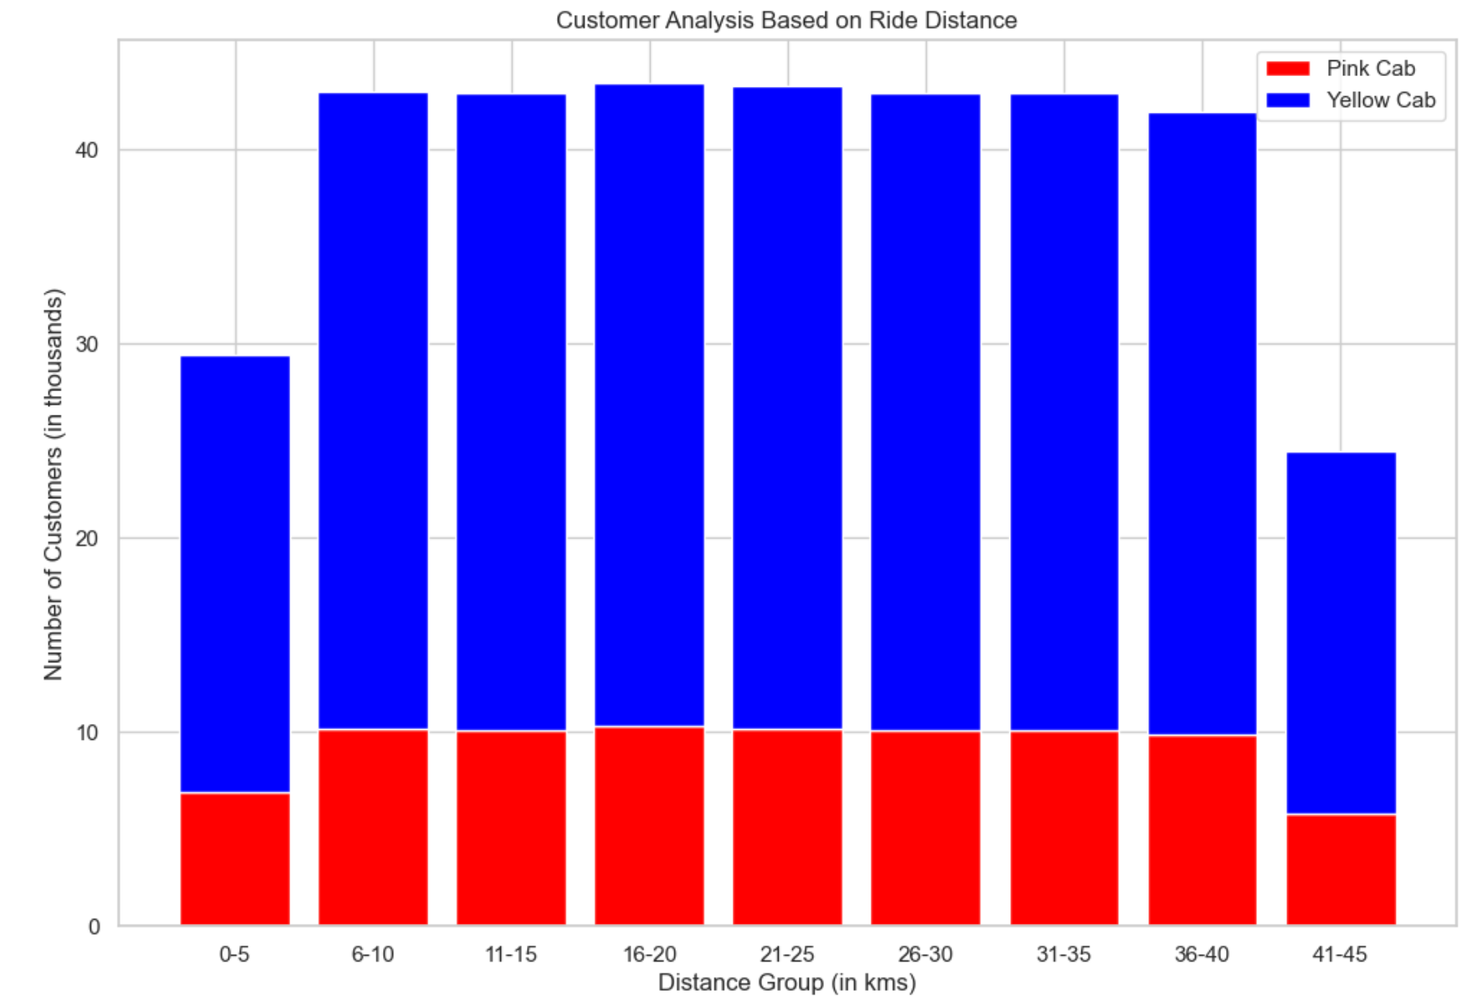
Customer Analysis on KM Travelled
Yellow Cab demonstrates a consistent customer distribution across short, medium, and long trips, indicating an effective customer plan for various trip lengths.
Yellow Cab is way better than Pink Cab when it comes to attracting customers for both short and long trips.
Yellow Cab has a strong customer base across various trip lengths, showing that it has a smarter plan compared to Pink Cab. This highlights Yellow Cab's superior strategy for attracting customers, especially in shorter and longer trips.

Slide 14
Recommendations
Profit Analysis:
Yellow Cab consistently outperforms Pink Cab in terms of profit over the three years.
Yellow Cab's profit per kilometre is more than twice that of Pink Cab, indicating a higher efficiency in generating revenue.
Customer Reach:
Pink Cab has a stronger presence in only four cities, whereas Yellow Cab dominates the rest.
Yellow Cab exhibits superior customer retention with a higher number of repeat customers.
Age-Wise Analysis:
Both companies share a nearly equal distribution of customers across different age groups, with the 18-29 age group contributing the most to profits.
Gender-Wise Analysis:
Males contribute more to profits than females for both Yellow and Pink Cabs.
Month-Wise and Day-Wise Demand:
Both companies experience an increase in the average number of trips from July to December, with December being the peak month. February sees the lowest demand.
Weekends witness higher demand, while Monday shows the least activity in terms of rides and customers.
Customer Analysis based on Kilometers Traveled:
Yellow Cab attracts a diverse customer base across various trip lengths, indicating a well-planned strategy compared to Pink Cab.
Conclusion: Based on the comprehensive analysis, I recommend investing in Yellow Cab due to its consistently higher profits, superior customer reach, and effective strategies for attracting and retaining customers across different factors.

Slide 15
I
Thank You

